Slide 1
Here is the Secret….

Slide 2
The secret is there is no secret.
Its just boring old habits. Its getting your work in everyday when nobody is watching.

Slide 3
The best product was and is
Belief

Slide 4
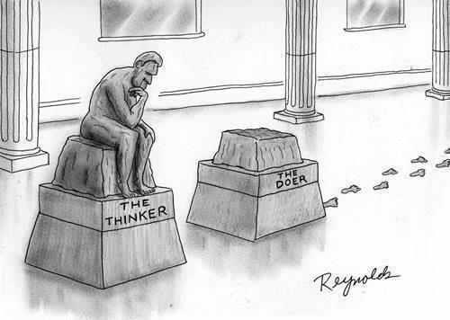

Slide 5
Add Two Possibilities/Day
Call One/Day
Show One Business Plan/Week

Slide 6
Warm Market
Friends, family, neighbors, teammates
High school classmates
College classmates
Organizations, associations, or groups that you belong to or have belonged to
Work colleagues (current and past positions)
Building A Names List
Social media

Slide 8
Adding to your names list is just as important as building it
Possibilities Are Everywhere
Add two names per day

Slide 9
Always be asking questions!
What do you do for a living?
How long have you worked here?
How long have you lived in the area?
What brought you to this area?
What does your spouse do?
Do you have family in the area?
Do you do this full time?
Do you keep your options open?

Slide 10
TOP 10 LIST
After building your list, prioritize the list
Approaches are determined for the top 10 with your business partner
Continue to build relationships with everyone on your list

Slide 11
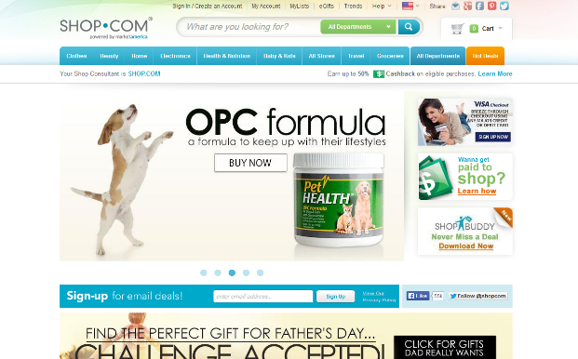
Answer
We are really a hybrid between franchising, internet marketing and traditional business. We take the best of each to create an entirely new concept called the UnFranchise.
The answer should be short and intriguing
The goal is to start or continue the dialogue

Slide 12
What is it?
We are really a hybrid between franchising, internet marketing and traditional business. We take the best of each to create an entirely new concept called the UnFranchise
What do I do?
I teach people how to make a lot of money online with a new concept called the UnFranchise.
Jim Winkler

Slide 13
What is it?
It’s a way to make a lot of money online
What do I do?
I teach people how to make a lot of money online
Elizabeth Weber-Walliser

Slide 14
What is it?
It’s a product brokerage and internet marketing company that helps people turn their spending into earning and create a Shopping Annuity.
What do you do?
I help people create an ageless lifestyle with wellness solutions
Jacki Blasko

Slide 15
What is it?
It’s called the Shopping Annuity. Have you ever heard of it?
Basically I help people take money they are already spending on every day stuff and turn it into a business that pays them on an ongoing basis.
Colton Whited

Slide 16
What is it?
Have you ever heard of the Shopping Annuity?
It’s a way of taking the dollars you are already spending and putting them into a business for yourself. I can’t believe you have never heard of it.
Ke and Joe Gerard

Slide 17
What is it?
A business system for people who want more income but don’t want another job
Lynn Mitschke

Slide 18
Call workshops
TEAMWORK
Working together gets results

Slide 19
WHY DO CALL WORKSHOPS WORK?
It is scheduled
Power of positive energy of two or more people
Coaching
Starts a new person fast
Accountability
Continues momentum in the business

Slide 20
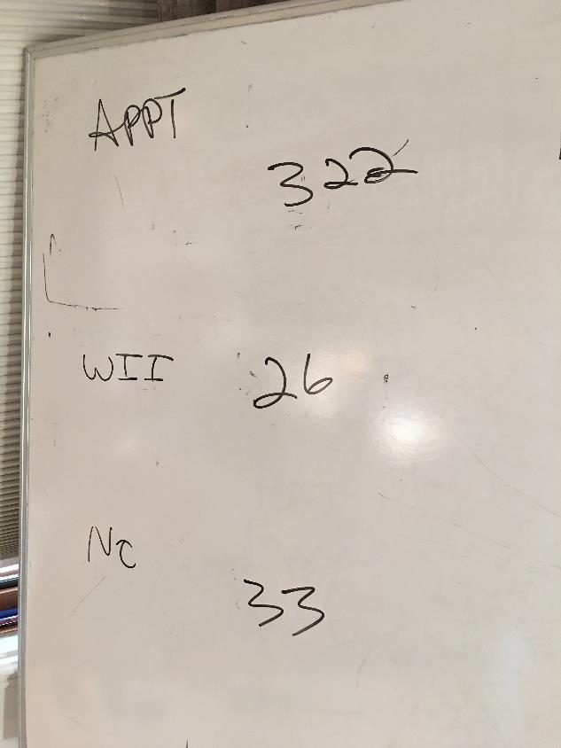
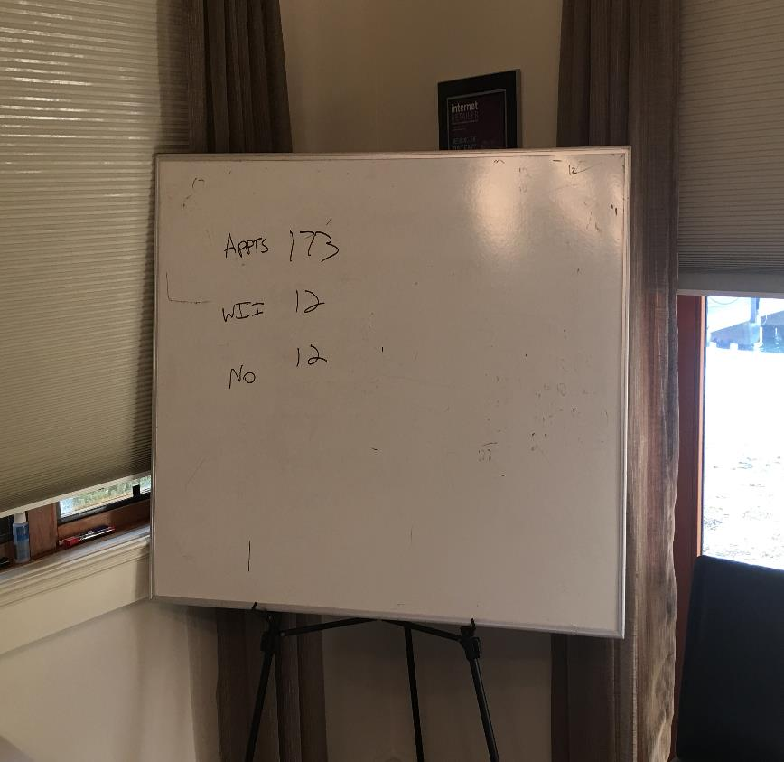

Slide 21
FREQUENTLY ASKED QUESTIONS:
What happens if I get a voice mail?
Can I text someone to let them know that I will be calling?
What if a call starts to go too long?
What if someone keeps asking questions?
Can I do a call workshop from a distance?

Slide 22
Ways of asking for the appointment
Referral
Evaluation
Direct (direct indirect)

Slide 23
Key Words/Phrases
Help
Expanding/Growing
No Pressure/Information only
May or may not be interested
Willing to evaluate
Lead

Slide 24
Texts before the calls:
Are you available for a quick phone call?
Can I give you a quick call?
Chat? Available?

Slide 25
Make the calls Hit key points
I only have a second,
the reason I’m calling is _____
You may or may not be interested, either way is fine with me
1
4
Edify (you may know the right people)
Can you help me out?
2
5
I want to get together for coffee (Could be with or without your business partner)
If the date doesn’t work – ask, “When is the soonest we can get together”
3
6
Do you see anything in your schedule between now and then that would prevent you from keeping our appointment?
7

Slide 26
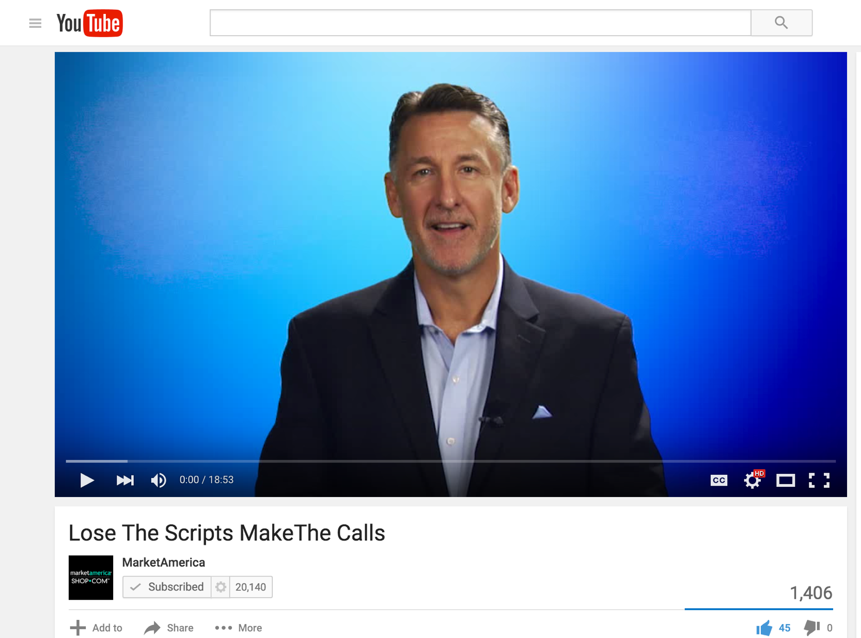

Slide 28
Mobile App

Slide 29
Result Producing Activities
Use and Sell the Products
Share the Business
Share the Shopping Annuity
Sell Tickets (Education)

Slide 30
LEARN HOW TO SHOW THE PLAN

Slide 31
Power Profiles
UnFranchise Owner Magazine
Flip Chart Online Presentation
UnFranchise Business Presentation (PPT)
23 minute video (YouTube)
Annual Report
About Market America and SHOP.COM
UnFranchise Mobile Prospecting App (UFP)
Websites (MY/SG.SHOP.COM, Global.SHOP.COM, MarketAmerica.com, etc.)
Product Catalogs
Home Shopping List / Shopping Annuity Assessment
Ways to share the
UnFranchise Business

Slide 32
BEFORE THE PLAN
Ask questions and learn about them
FORM (Family, Occupation, Recreation, Money)
Expose their pain
People will be attracted when you show that you care,
you are excited, and you believe in your business
People buy you

Slide 33
DURING THE PLAN
Let them know that you and your team will support them
(in business for themselves but not by themselves)
Explain how the system will help them
Let them know that some people will be skeptical or negative (crucial)
Be prepared to ask if they are interested in getting started or learning more

Slide 34
Scheduling the follow up appointment
It is a successful meeting if a
follow up is
booked
Have your schedule available and book the next step
Schedule a follow up meeting to answer questions or get started
You have to continue to follow up until they get started or let you know they are not interested
Sense of urgency is crucial, book the follow up within 48 to 72 hours if possible

Slide 35
Scheduling the
follow-up appointment
If it’s to answer questions
If it’s to get them started
Answer questions
Sell tickets
Get them to lead to their people
Book registration date
Sell product
Help qualify top ten possibilities
Sell tickets

Slide 36
Confirm the next appointment
Send them a webinar link
Send them About MA document
Send them videos (YouTube, MeetOn, Power Profiles)
WHAT TO DO BETWEEN APPOINTMENTS
Schedule a three way call

Slide 37
Keep the
Main Thing
the Main Thing

Slide 38
Result Producing Activities
Use and Sell the Products
Share the Business
Share the Shopping Annuity
Sell Tickets (Education)

Slide 39
Duplication
Sell Tickets (Education)
No Ticket, No Money!

Slide 41
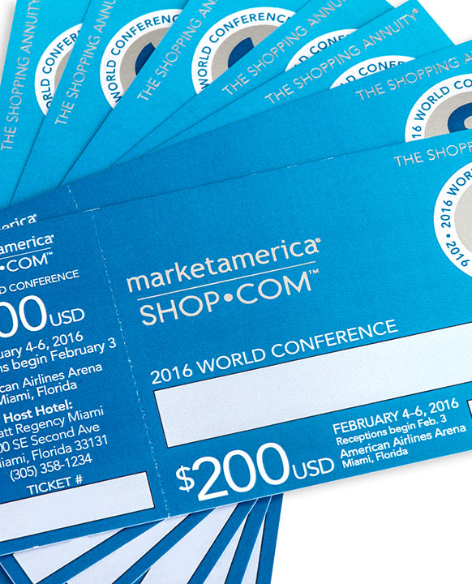
After showing the plan (follow up)
After the UBP
During new business owner registration
Create a sense of urgency
Selling Tickets
(education)
During call workshops
Call stable and waiting

Slide 42
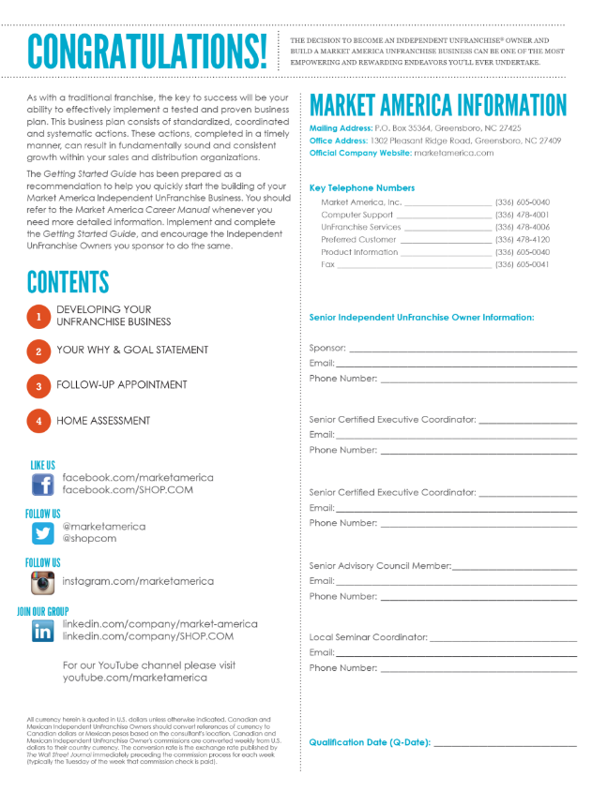
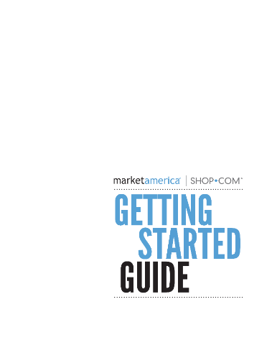
Getting Started Guide

Slide 43
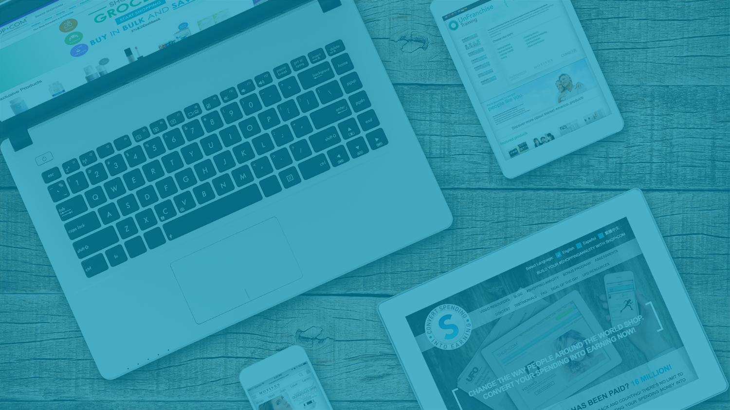
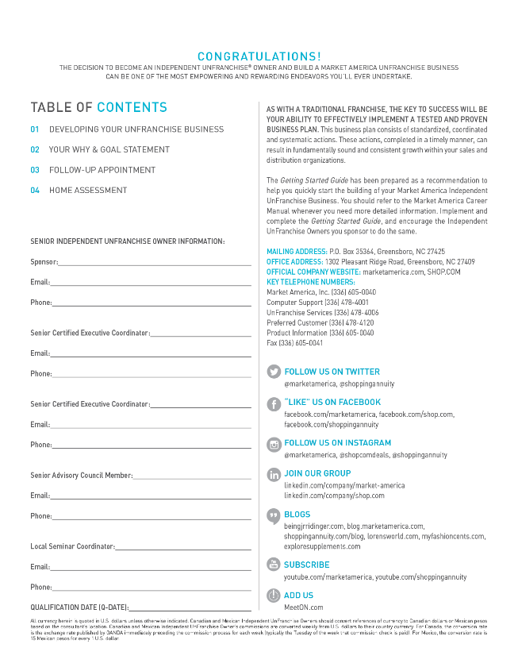

Slide 45
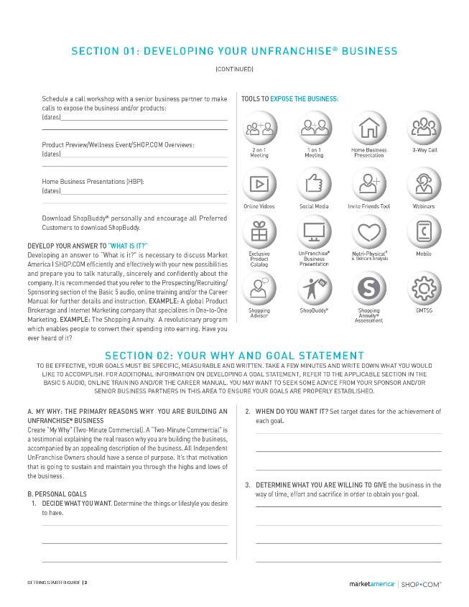

Slide 46
MASTER UNFRANCHISE OWNER (UFO) CRITERIA CALENDAR QUARTERLY QUALIFICATIONS:
Complete the Shopping Annuity Online Assessment.
Have a subscription for the UnFranchise Management System (UFMS).
Purchase a total of 1500 BV/IBV of MA exclusive product for the respective quarter. These product purchases must be from your paying UnFranchise ID or from a personally registered Preferred Customer’s paying ID.
Generate USD1500 worth of Partner Store purchases between you and your customers. Partner Store purchases must be from your paying UnFranchise ID and/or from registered PC’s paying ID.
Enter the names and the UnFranchise Identification Numbers of the two qualified and active UnFranchise Owners that you personally sponsored for the respective calendar quarter.

Slide 47
MASTER UNFRANCHISE OWNER (UFO) CRITERIA CALENDAR QUARTERLY QUALIFICATIONS:
Attend or conduct one New UnFranchise Owner Training (NUOT).
Attend or conduct one Basic 5 Training (B5).
Attend or conduct one Executive Coordinator Certification Training (ECCT) per calendar year.
Purchase a minimum of three tickets to Annual Convention and a minimum of three tickets to Leadership School.
Complete a Basic 5 Diagnostic Test, in which you score greater than or equal to 50 percent. AND/OR Earn a minimum of USD900 in commissions for the respective quarter (BV and/or IBV).

Slide 48
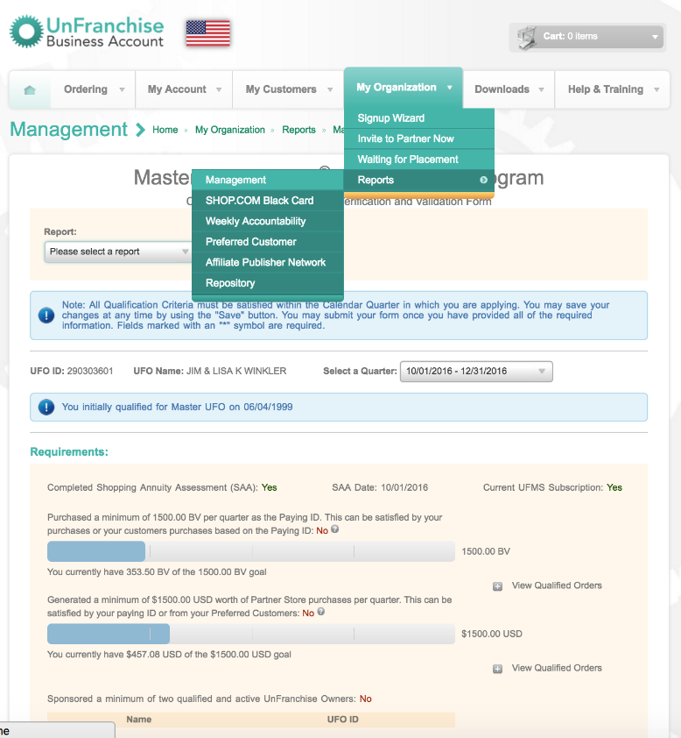

Slide 49
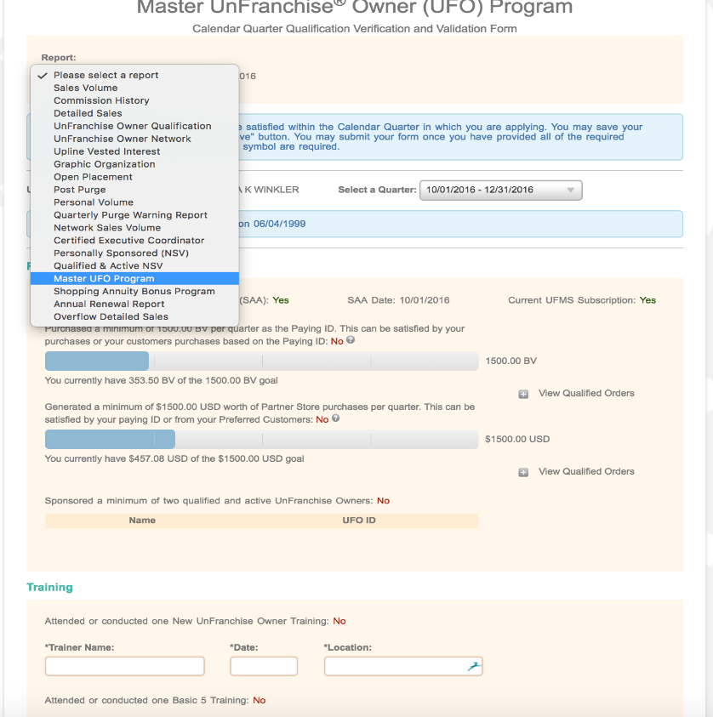

Slide 50
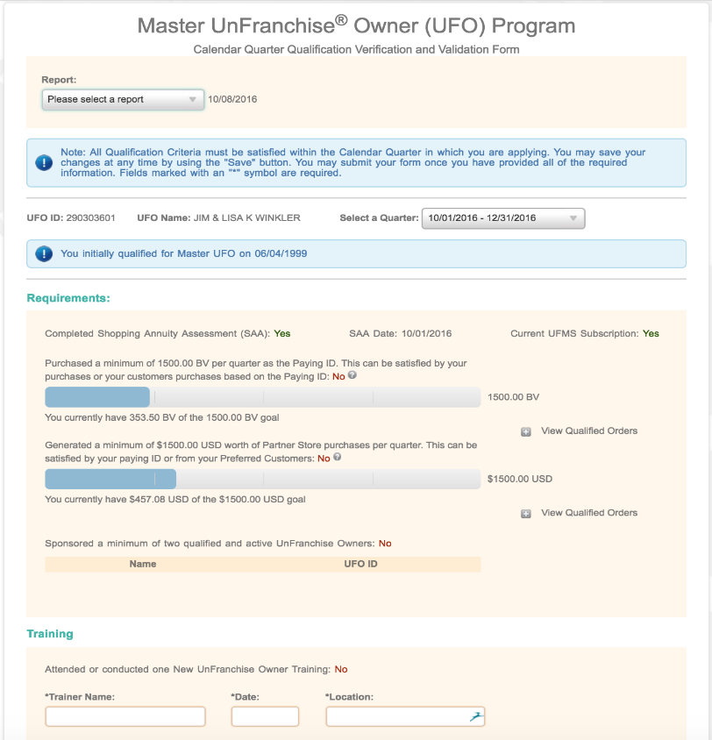

Slide 51
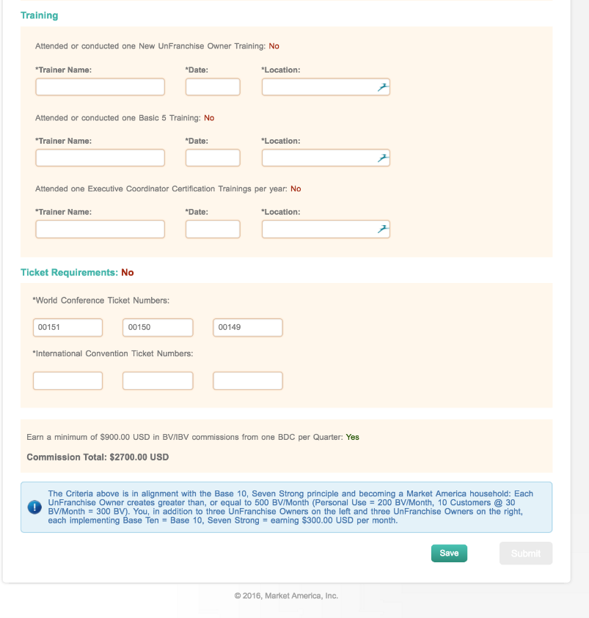

Slide 52
The secret is there is no secret.
Its just boring old habits. Its getting your work in everyday when nobody is watching.

